Slide 1
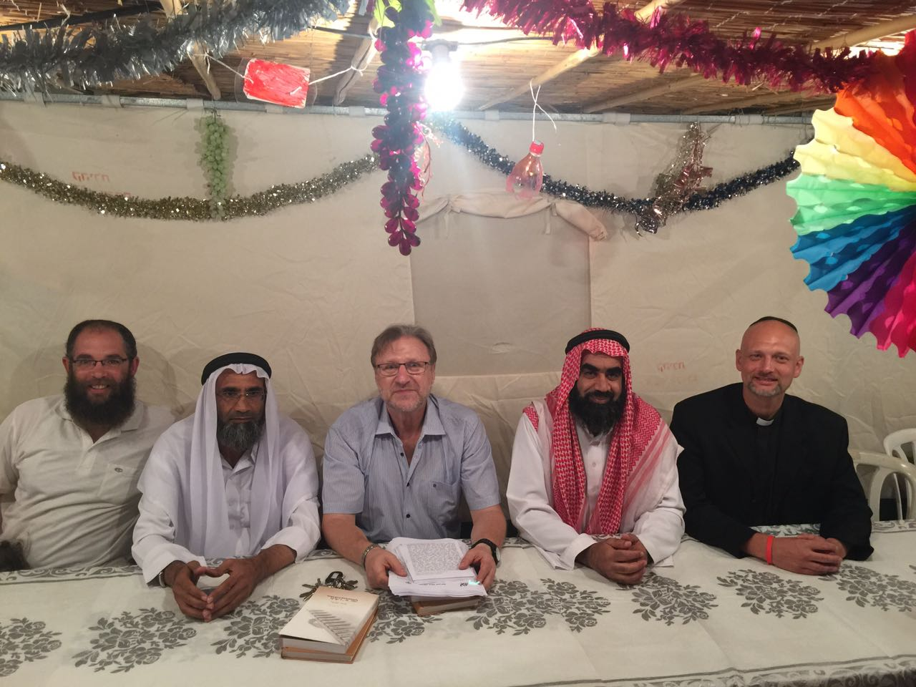
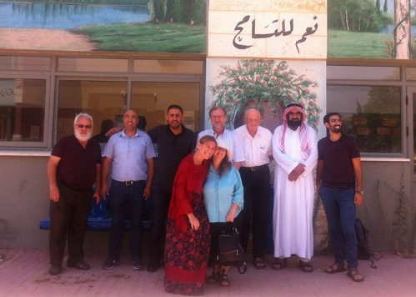
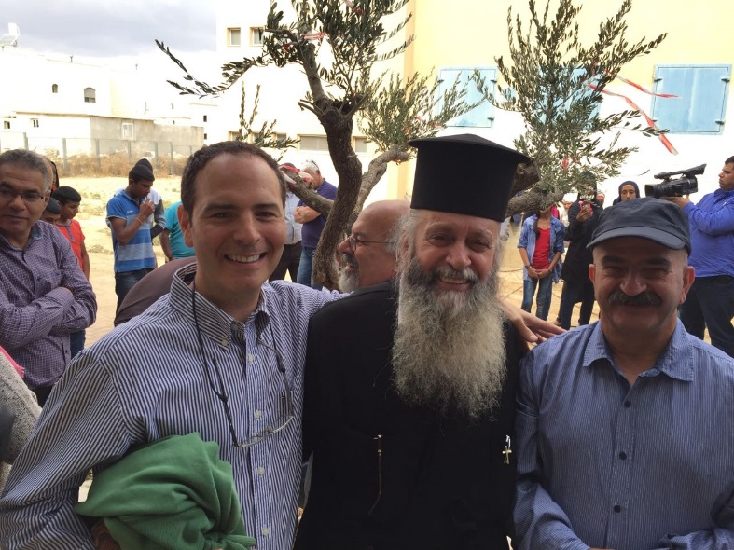

Slide 2
Visionהחזון الرّؤية
Getting to know the communities in the region
הכרת התרבות של בני הדתות השונות החיים באזור הנגב.
التعرف على ثقافات الديانات المختلفة في منطقة النقب.
Interfaith dialogue, through respect and sharing
דיאלוג בין-דתי תוך כיבוד כל הבריות ותרבויותיהן.
رعاية حوار بين الديانات مع احترام كل المجتمعات وثقافاتهم .
Listening to the needs of the other
קיום הקשבה אמתית למצוקות האחר.
إصغاء صادق لمعاناة الآخرين
Improving the lives of the people in the region
שיפור החיים של בני הדתות והאמונות השונות באזורנו.
تحسين التعايش بين أبناء الأديان والعقائد المختلفة في المنطقة.

Slide 3
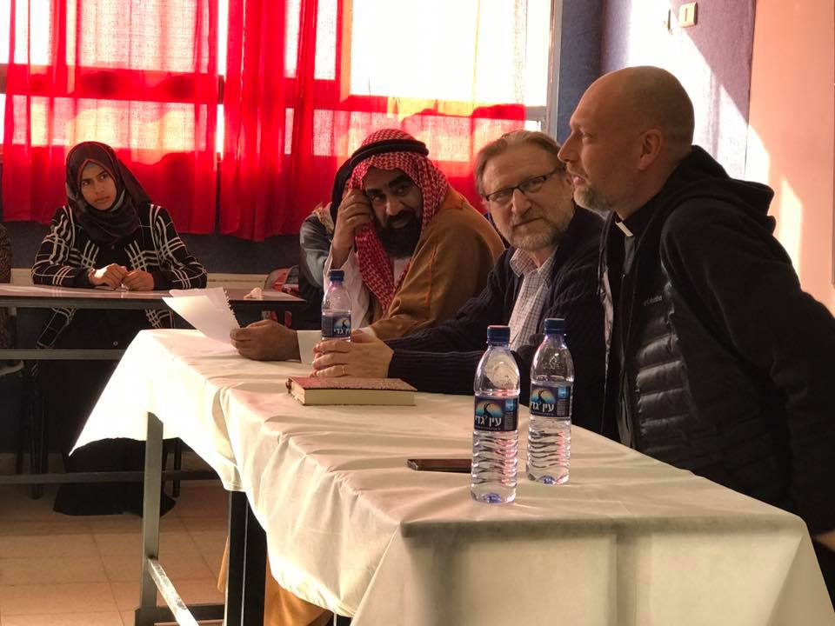
מטרות الاهدافGoals
Fostering relationships between religious local leadership that models mutual respect and cooperation.
Exposing society to religious leadership and religious sources that call for mutual respect and acceptance, both in one’s own religion and culture and in the other’s religion culture.
Experiencing the spiritual strength of pluralism rooted in religious and cultural identity that can generate social change while empowering people’s particular identity.
Protecting youth from religious extremism through offering alternative expressions for religious and cultural identity.

Slide 4
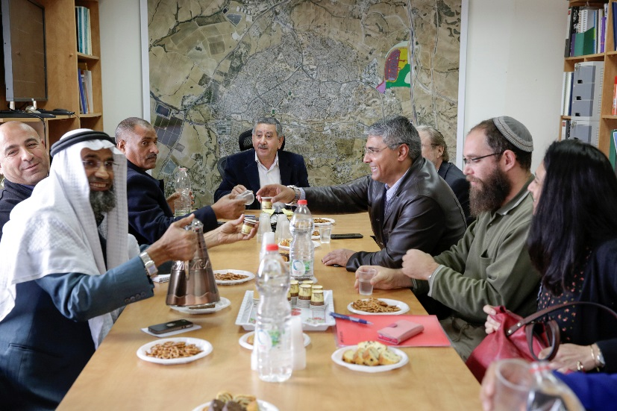
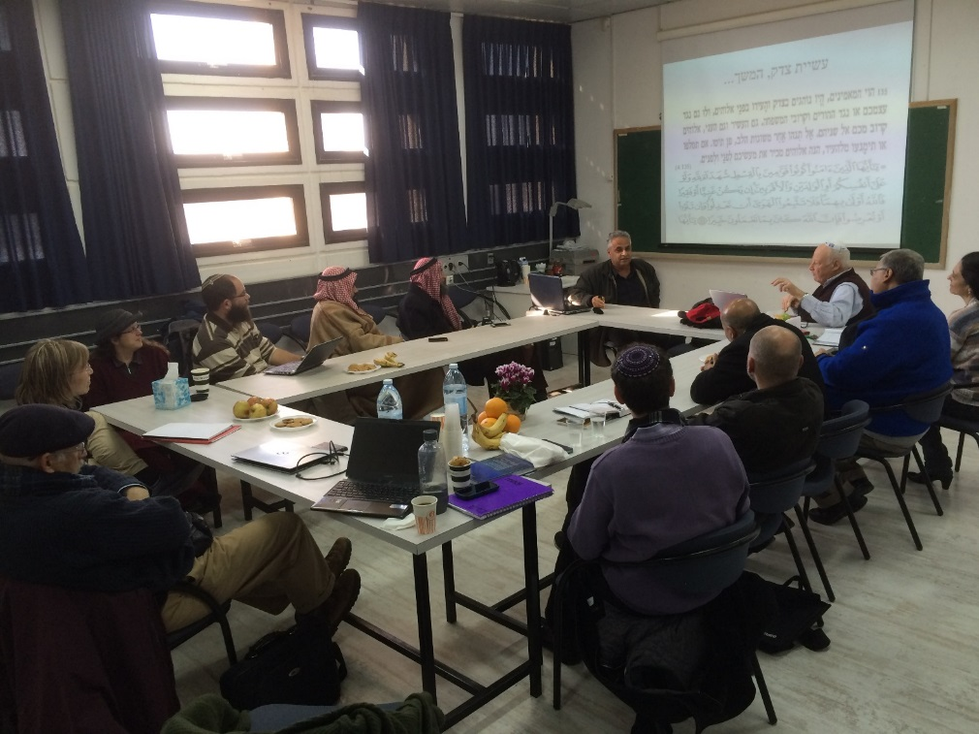
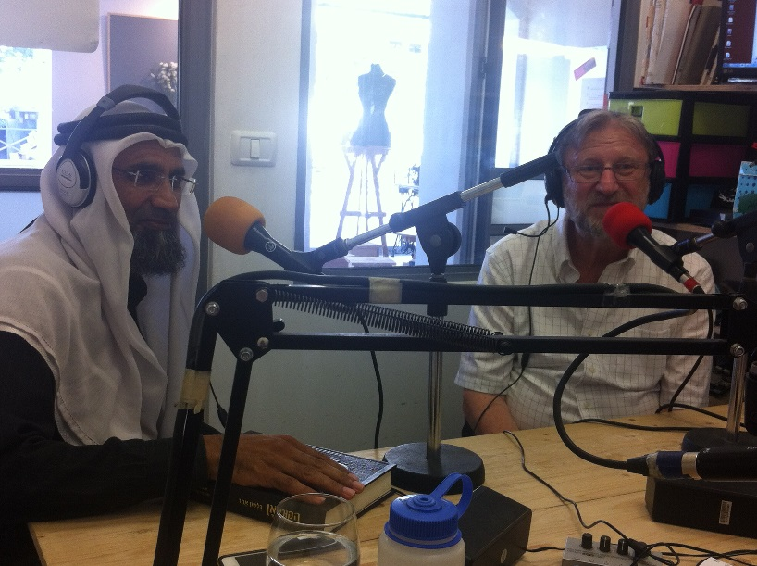
איך? كيف؟
Howאיך? كيف؟
Creating an Interfaith Team
Learning together and building a curriculum.
Exposure – Panels, meetings, Media
Entering the Academic and Educational institutions.

Slide 5
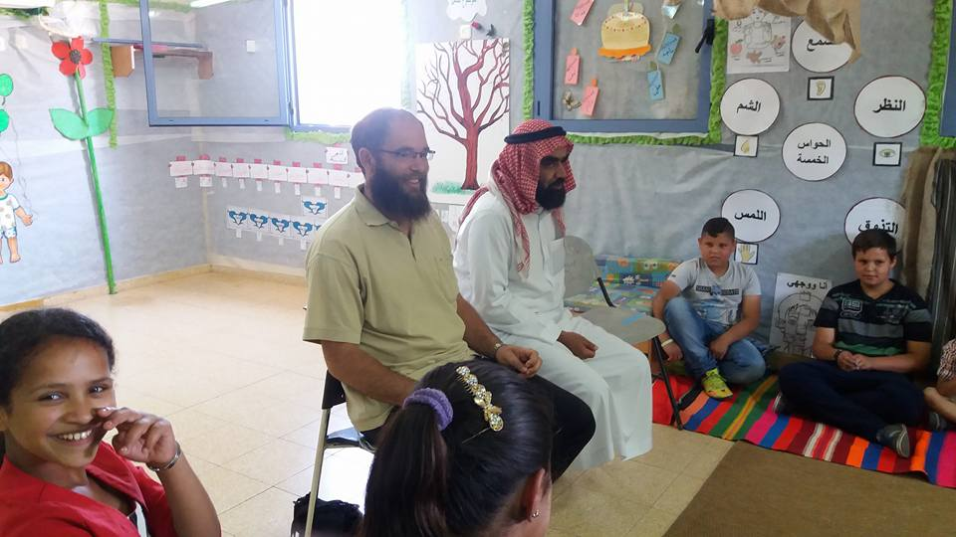
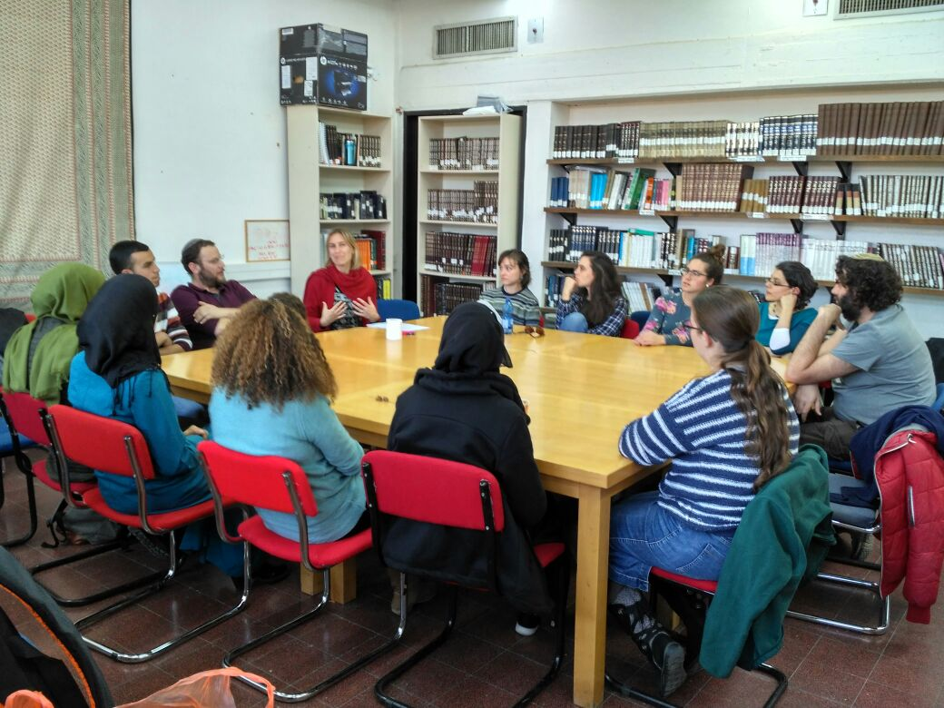
Routes of Action – 2017-2018
Pilot Program in Arab and Jewish schools:
Religious leadership enter schools and model dialogue between religious leaders and answer questions of students
. Course at Kay Teacher’s College:
“Dialogue between religions - is it possible?”
14 meetings of study, dialogue and meetings with local religious leadership.
Interreligious Program for Students at “Beit Midrash Daroma’ at Ben Gurion University.
Muslim and Jewish students, study sources from Islam and Judaism together while creating deeper acquaintance with one another.
Study program for teachers as part of the Ministry of Education’s program “Living together.”
Exposing teachers to interfaith dialogue and the contribution that interfaith dialogue gives to society.

Slide 6
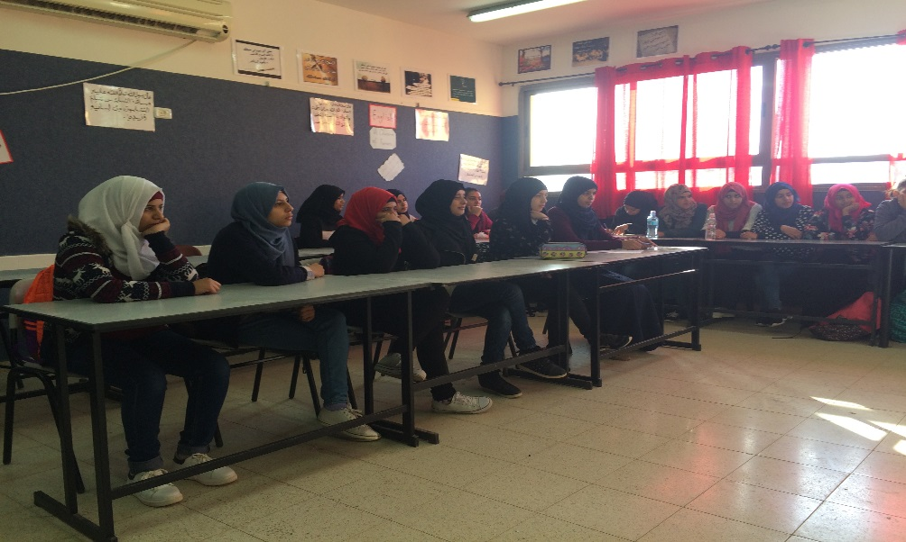
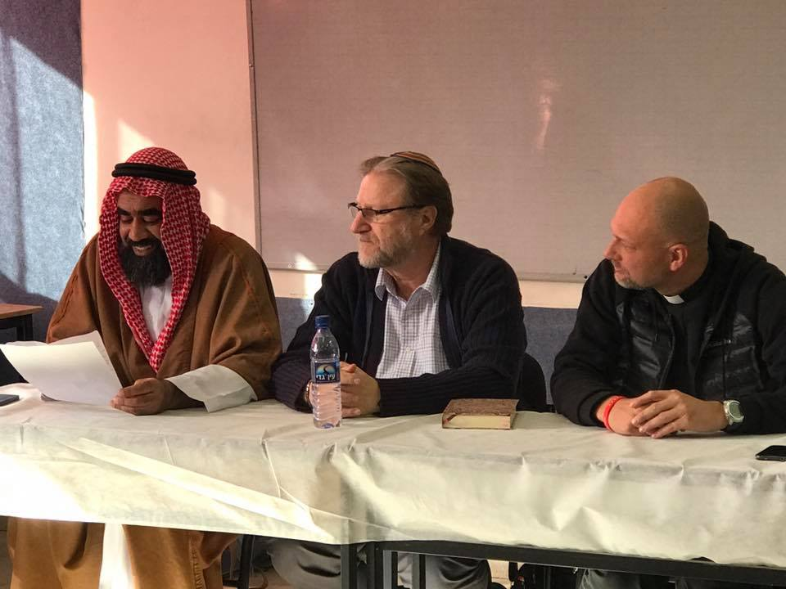
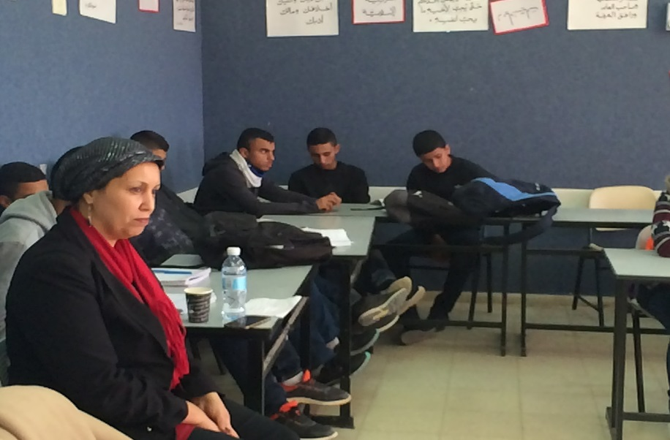
Pilot Program in Schools
Quran, Surah 49, Aya 13:
O mankind! We created you from a single (pair) of a male and a female, and made you into nations and tribes, that you may know each other (not that ye may despise (each other). Verily the most honoured of you in the sight of Allah is (he who is) the most righteous of you. And Allah has full knowledge and is well acquainted (with all things).
سورة الحجرات (49) اية 13:
يَا أَيُّهَا النَّاسُ إِنَّا خَلَقْنَاكُم مِّن ذَكَرٍ وَأُنثَىٰ وَجَعَلْنَاكُمْ شُعُوبًا وَقَبَائِلَ لِتَعَارَفُوا ۚ إِنَّ أَكْرَمَكُمْ عِندَ اللَّهِ أَتْقَاكُمْ ۚ إِنَّ اللَّهَ عَلِيمٌ خَبِيرٌ
הוי אנשים, הנה בראנוכם מזכר ונקבה, ועשינוכם אומות ושבטים להכיר אחד את השני (ולא לשנוא אחד את השני), הנה נשוא הפנים ביותר בכם אצל אללה, הוא ירא אללה ביותר , הנה אללה יודע ובקי. (סורת החדרים (49) איה 13)

Slide 7
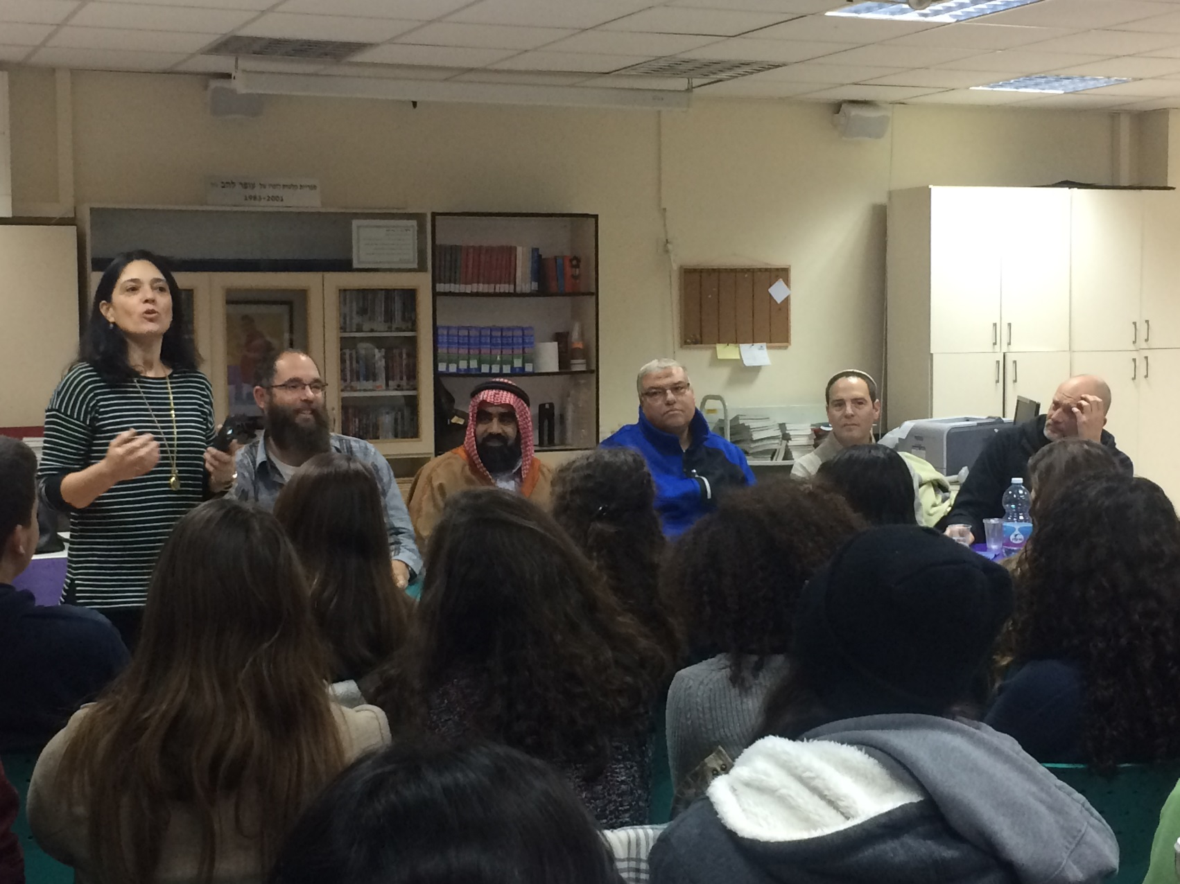
Pilot Program in Schools
Sanhedrin, 4, 5:
Therefore but a single person was created in the world, to teach that if any man has caused a single life to perish, he is deemed by Scripture as if he had caused a whole world to perish; and anyone who saves a single soul, he is deemed by Scripture as if he had saved a whole world.
לפיכך נברא אדם יחידי בעולם, ללמד שכל המאבד נפש אחת, מעלים עליו כאילו איבד עולם מלא; וכל המקיים נפש אחת, מעלים עליו כאילו קיים עולם מלא.
(מסכת סנהדרין, ד,ה)
لذلك خَلق الإنسان وحيدا في العالم لكي يتعلم أن من يفقد نفسا واحدة من العالم
يكون حسابه كأنه فقد العالم كله، ومن يساعد نفسا واحدة في هذا العالم كأنه يقيم العالم كله.

Slide 8
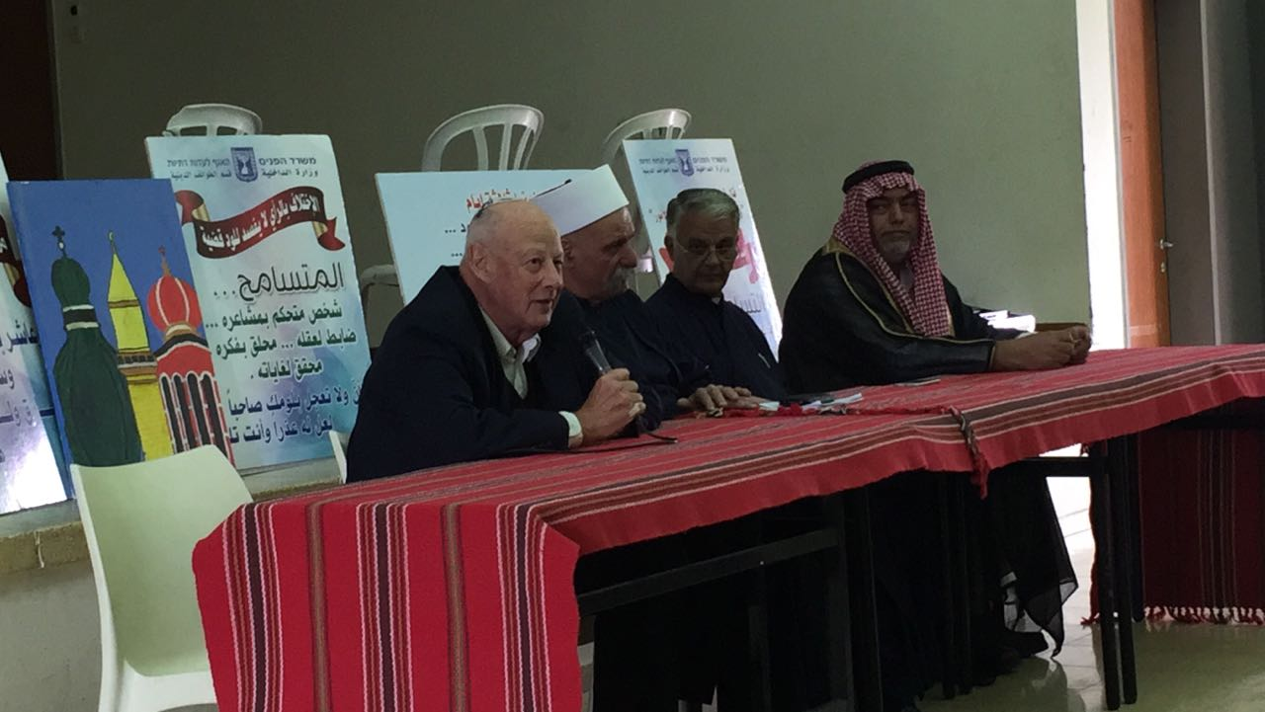
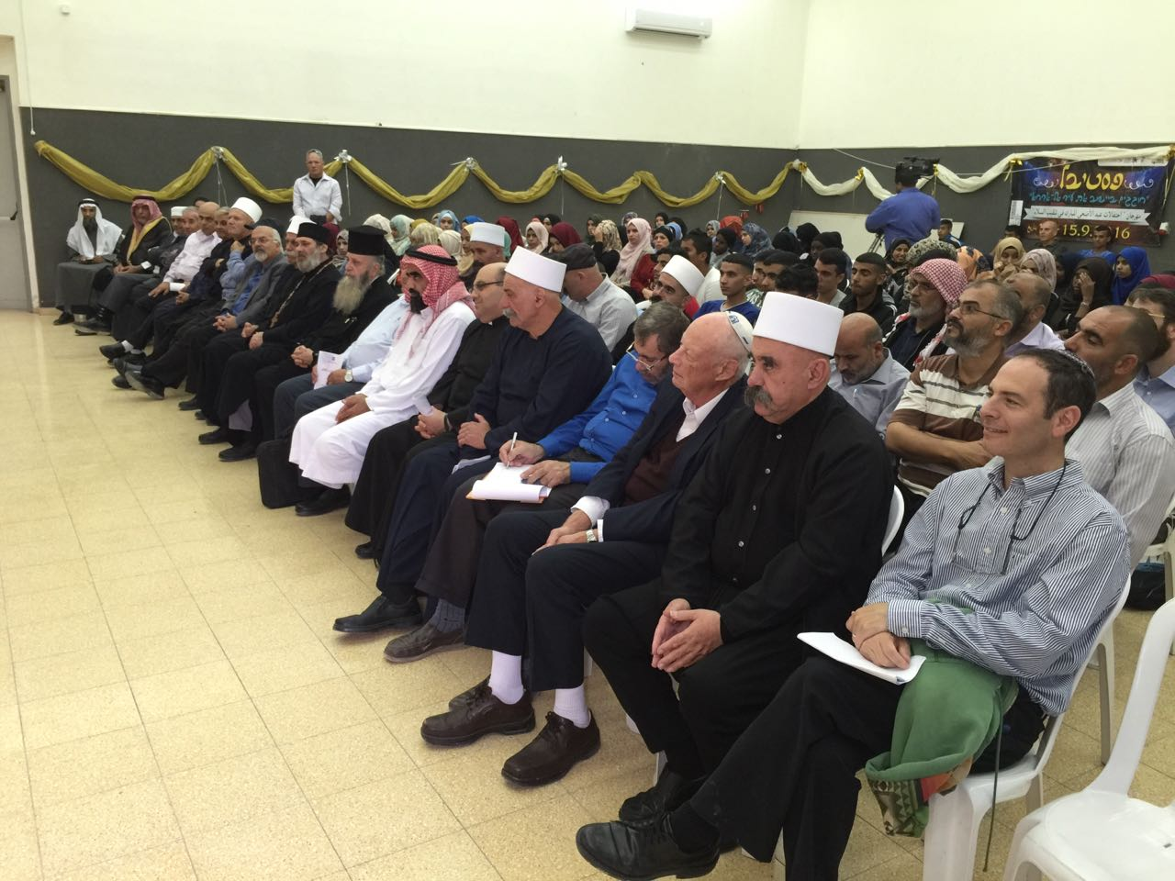
Tolerance Week in the Negev

Slide 9
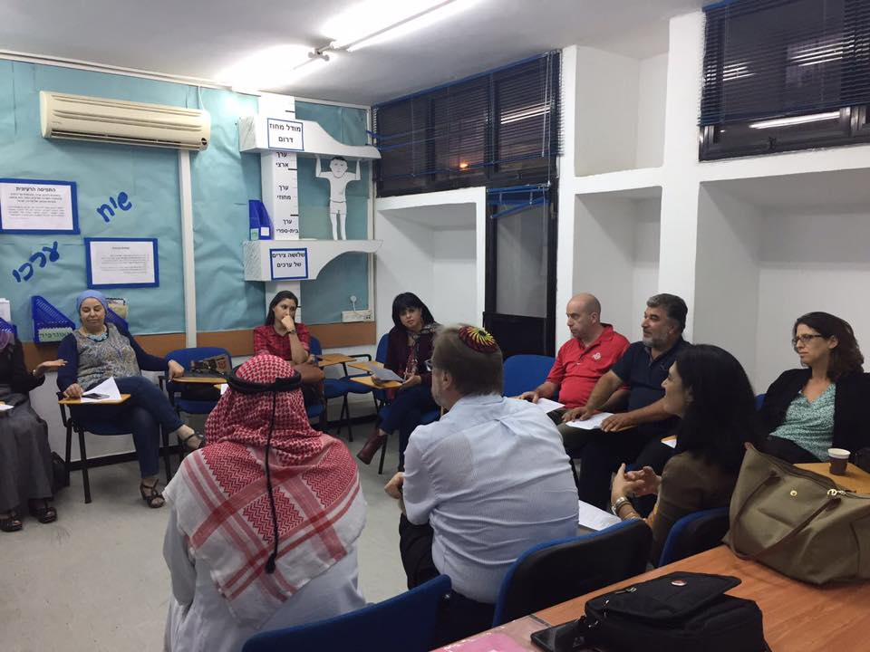
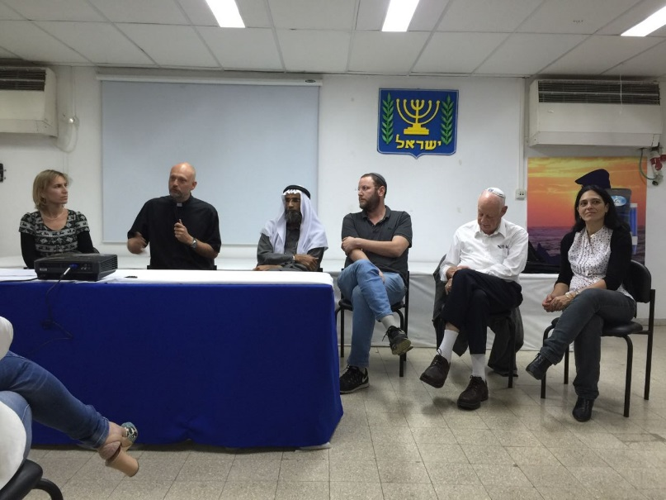
Teachers Programs

Slide 10
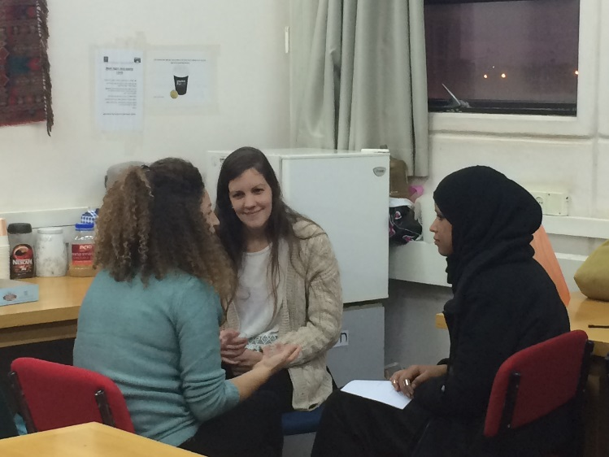
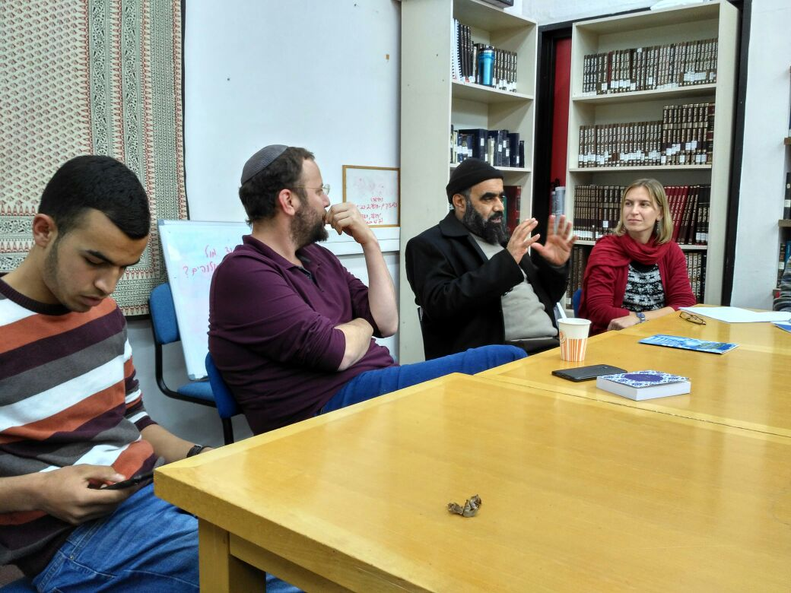
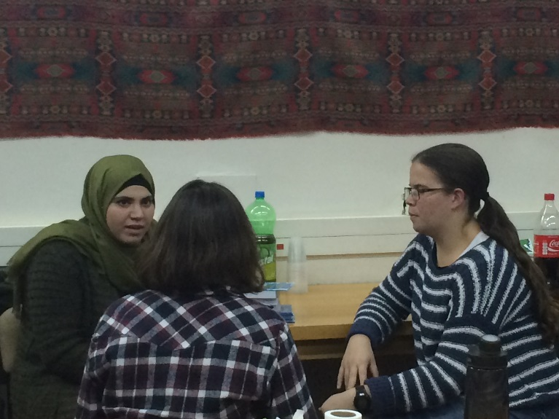
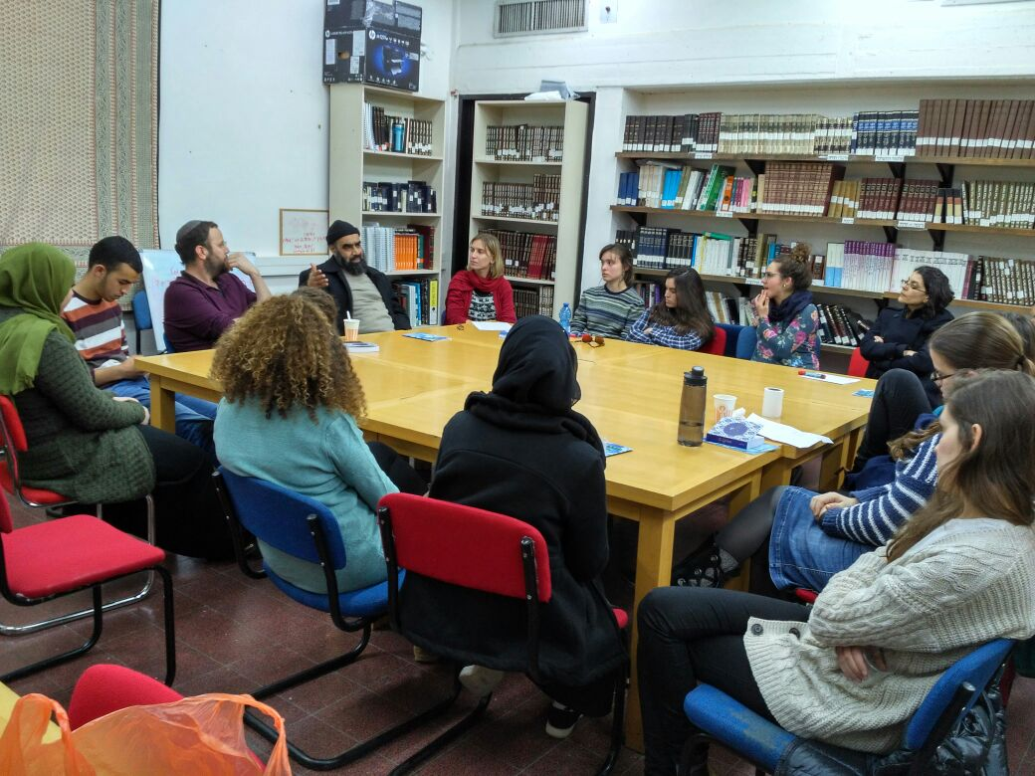
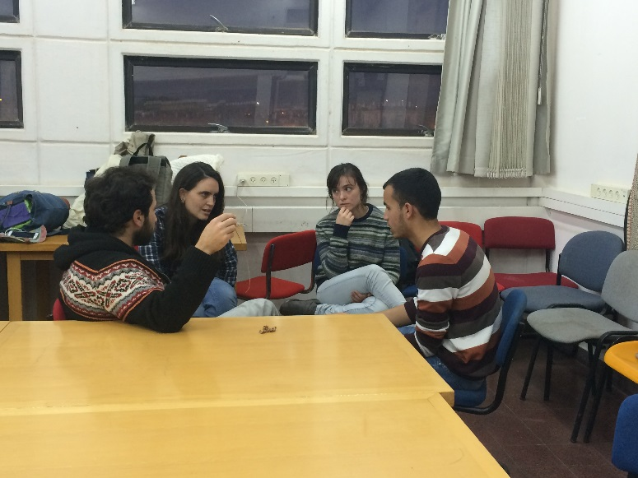
Student Program- Ben Gurion University

Slide 11
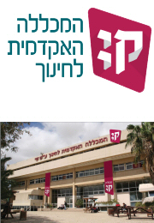
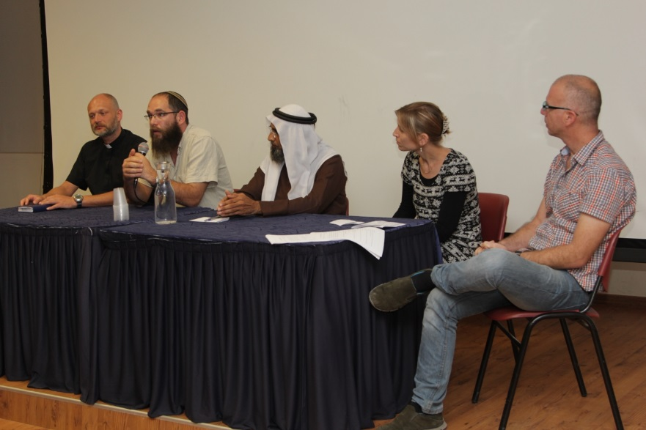
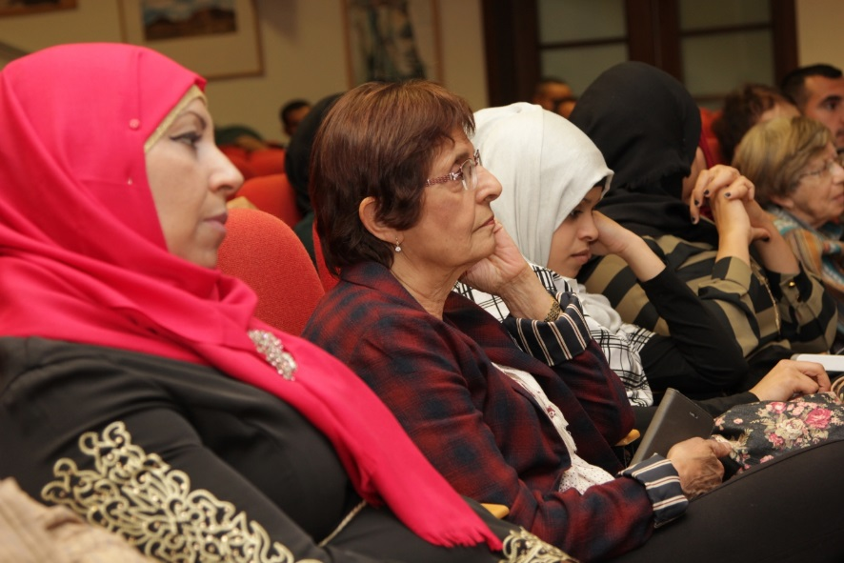
Kaye Teachers College

Slide 12
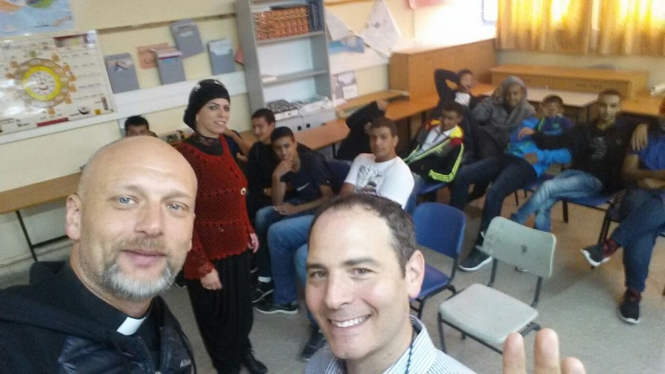
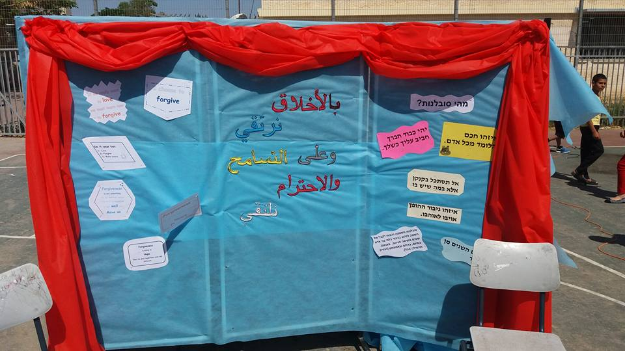
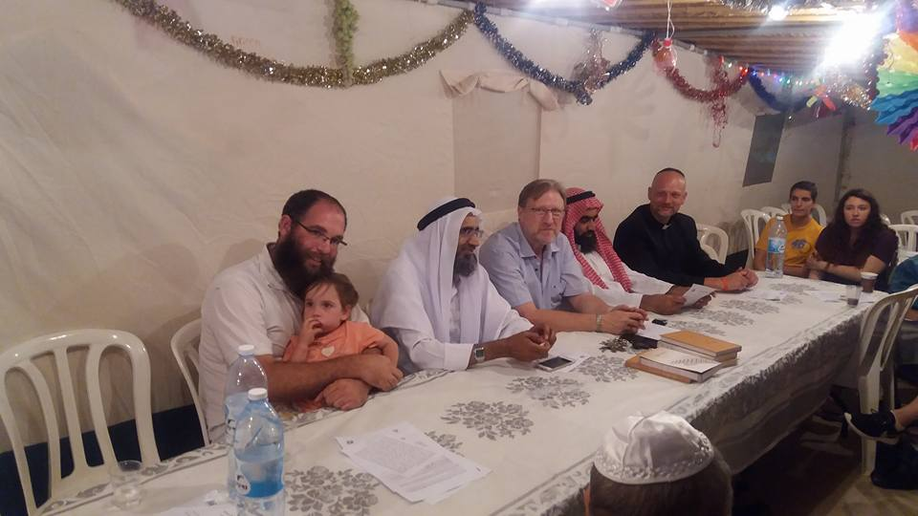
Help us continue our work:
Financial Support
Exposure

Slide 13
תודה רבה شكراً جزيلاً Thank you

